Slide 1
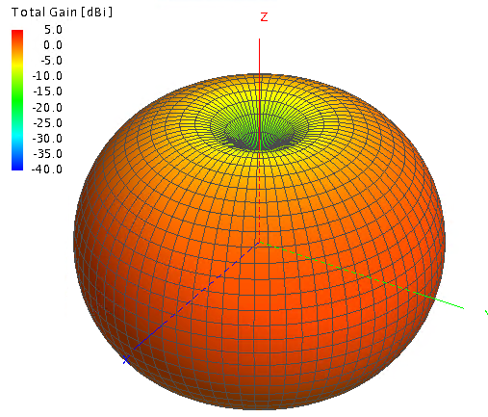
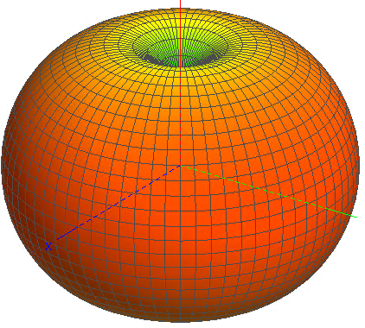
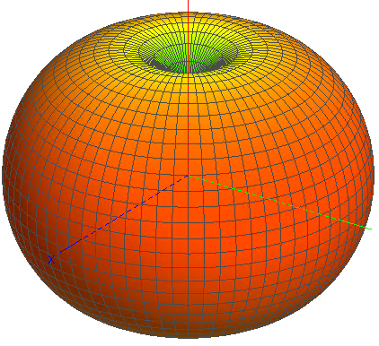
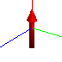
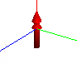

Ideal Source ($θ=0°, φ=0°$)
Electric Dipole
Electric ring current
Magnetic line current

Slide 2
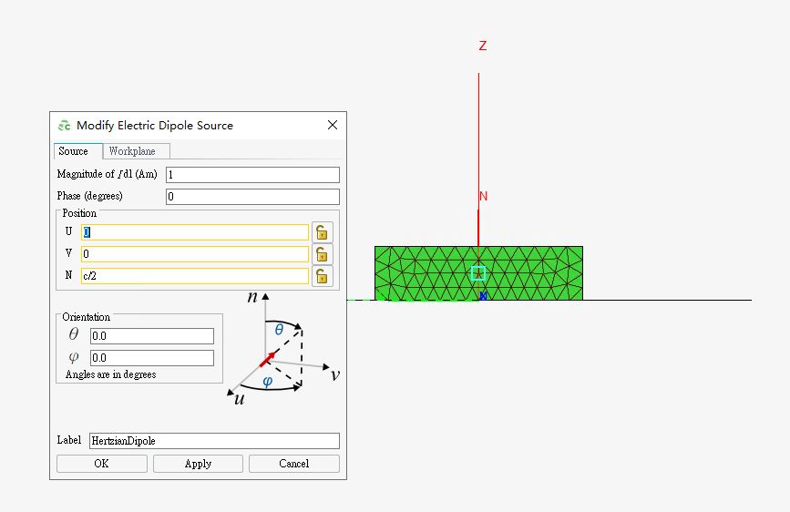
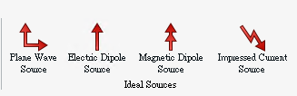
Feko provides several ideal sources
Note: not supported by CST and HFSS
E-Dipole for example

Slide 3
Characteristic Mode Analysis (CMA) of DRA
Kai FU
15-2-2023
ece.kaifu@my.cityu.edu.hk

Slide 4
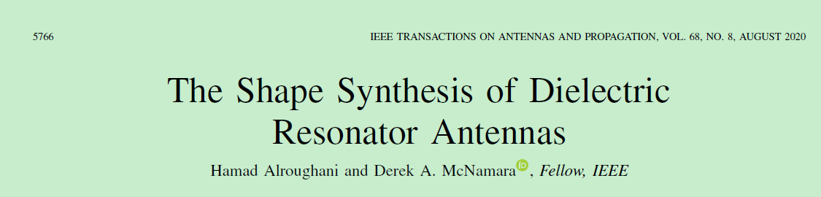
Main References

Slide 5
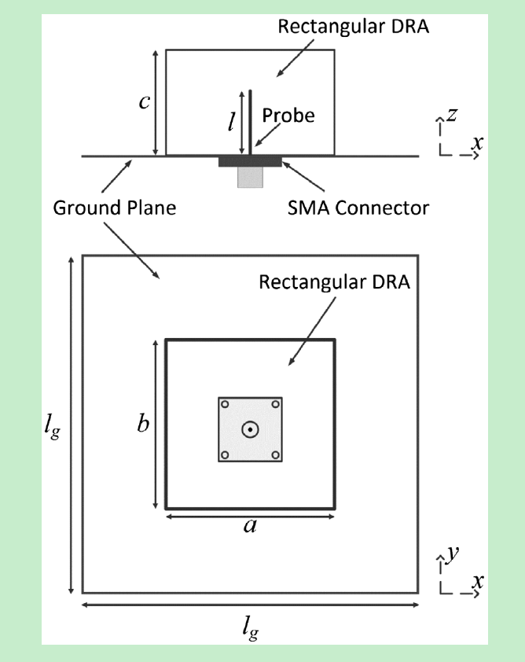
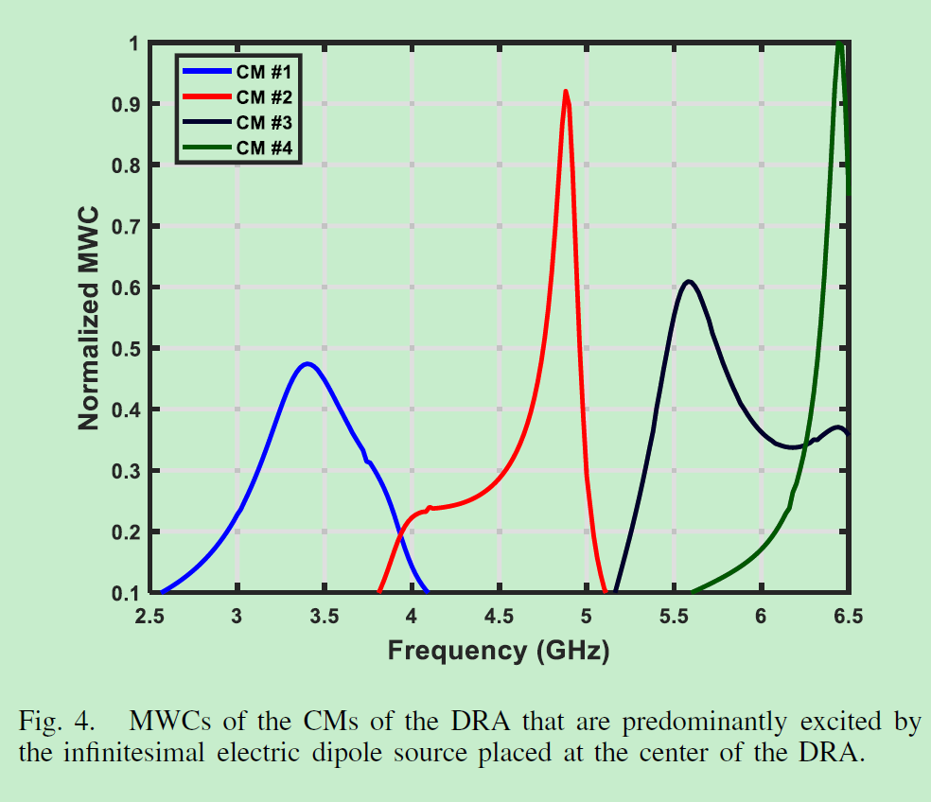
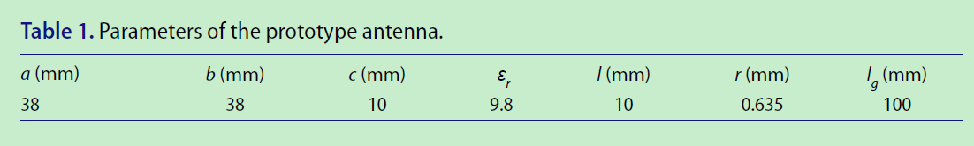
Aim: Reproduce Fig. 4

Slide 6
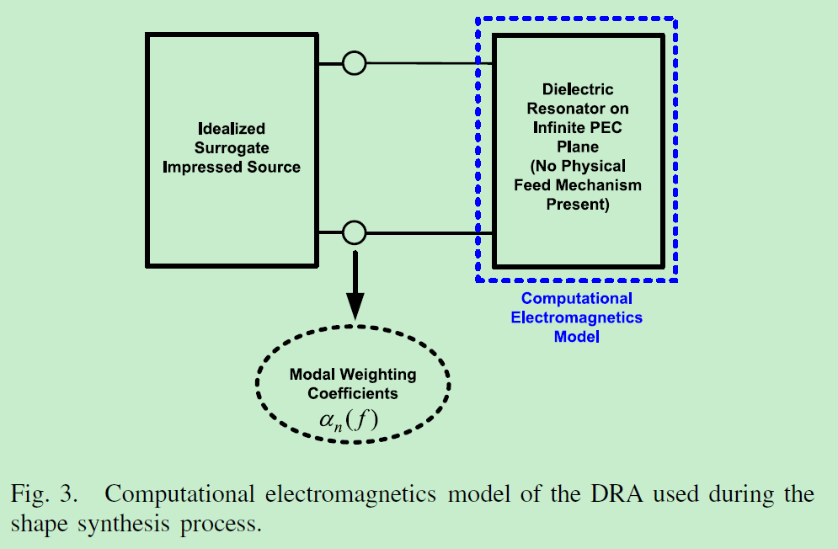
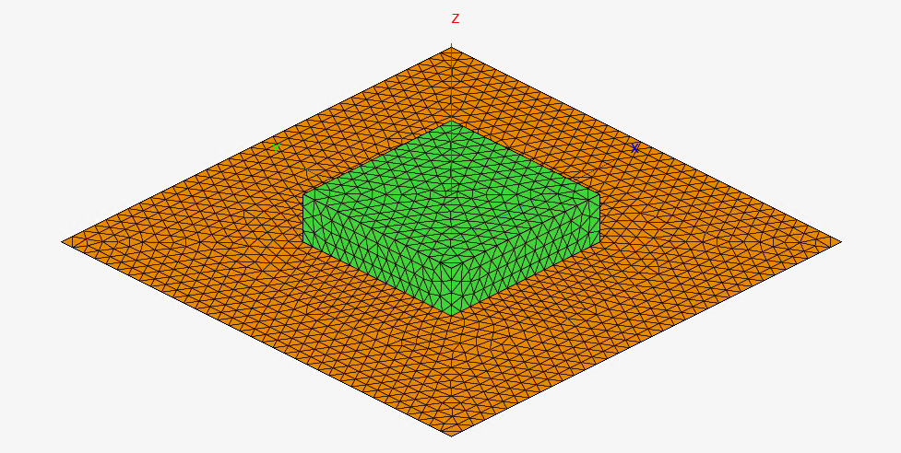
If it is a probe, we will represent it by a surrogate infinitesimal electric dipole.
If it is a slot, we will represent it by a surrogate infinitesimal magnetic dipole.

Slide 7
Feko provides several ideal sources
Note: not supported by CST and HFSS
E-Dipole for example

Slide 8
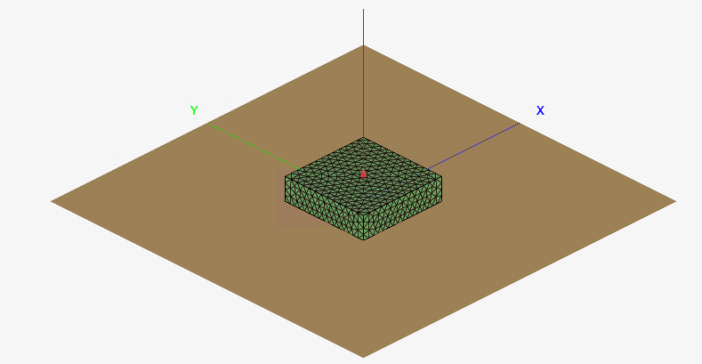
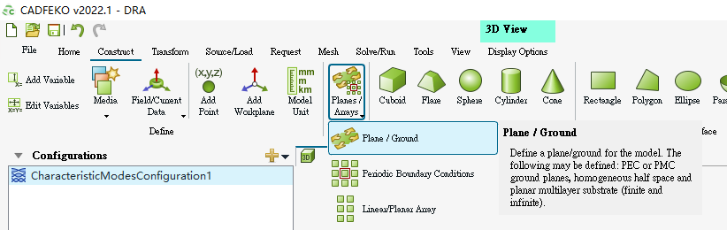
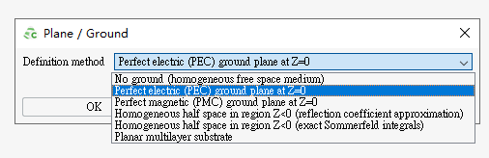
Previously: draw GND manually
Now: Green’s function configuration
Construct -> Planes/Arrays -> Planes/Ground -> PEC at Z=0

Slide 9
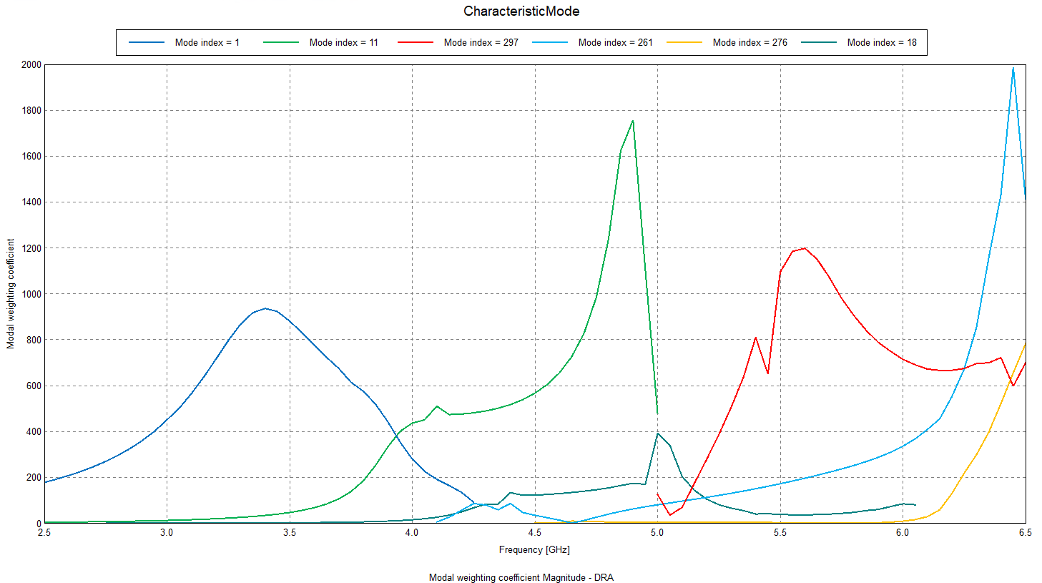
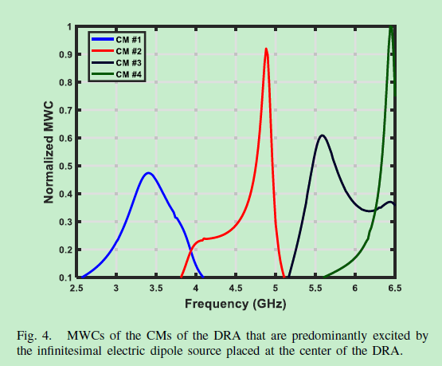
Previous results
Now
Reference

Slide 10
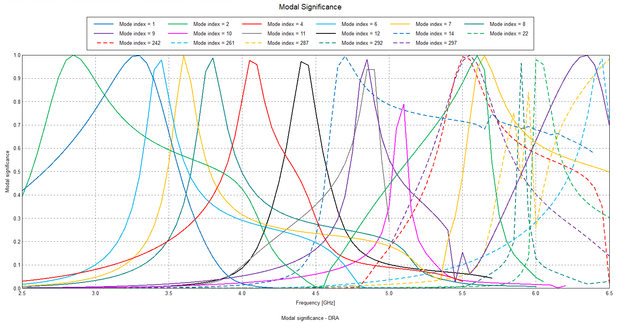

Slide 11
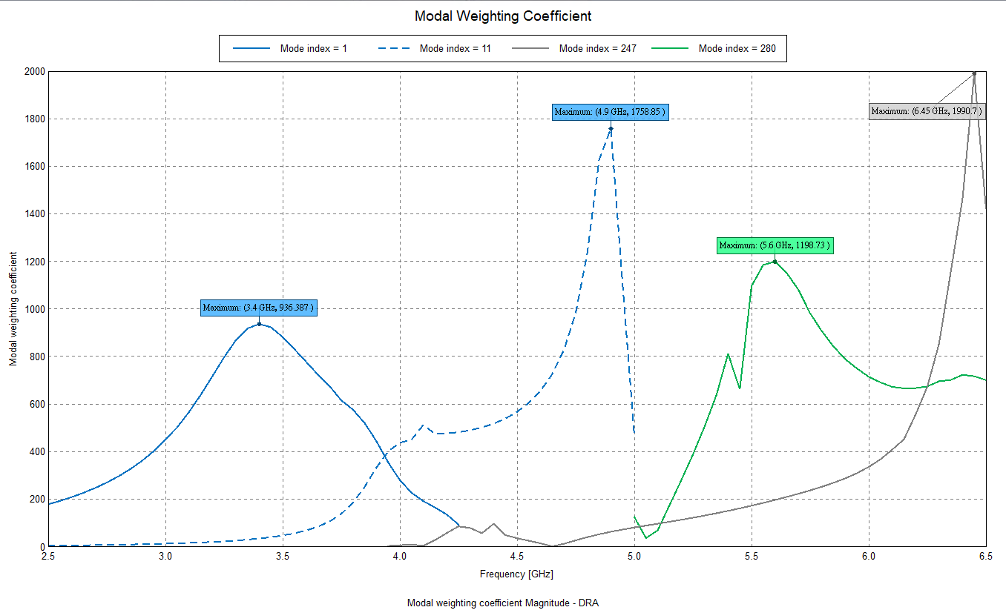
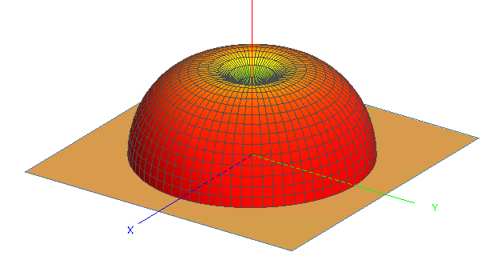
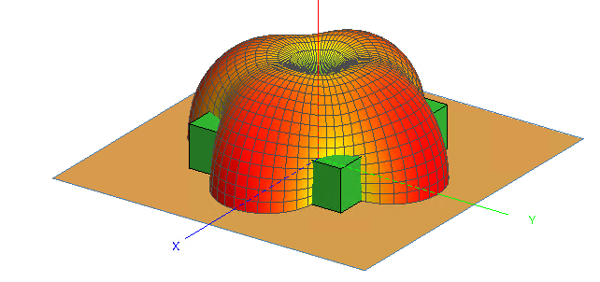
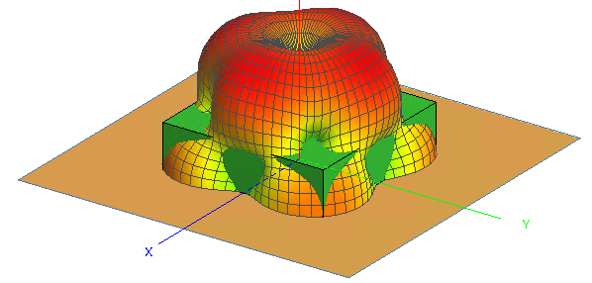

Slide 12
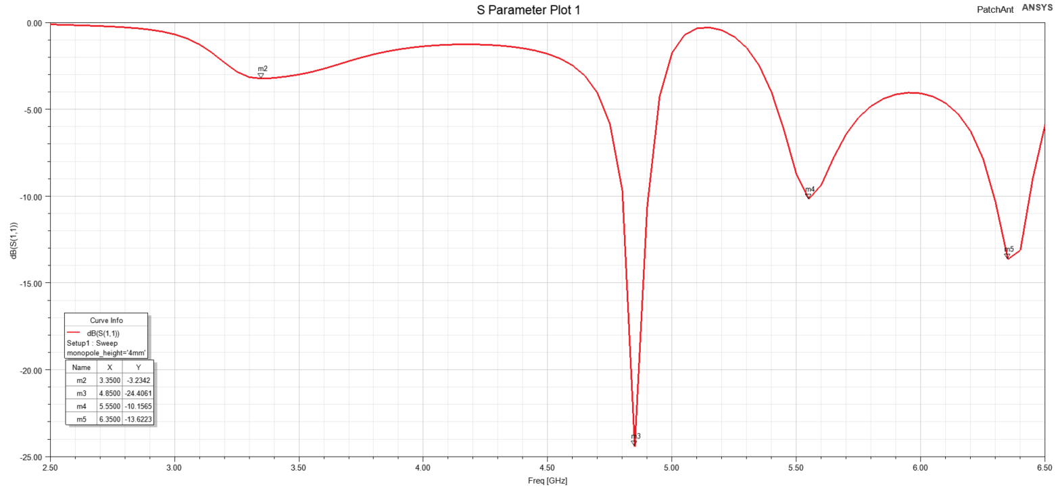
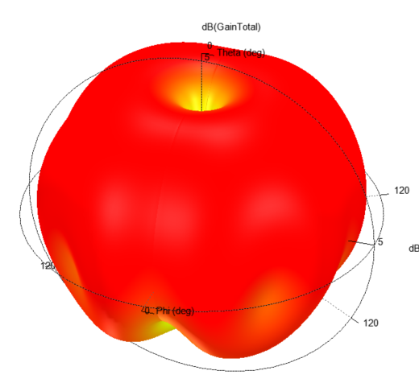
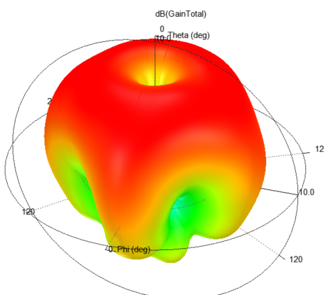
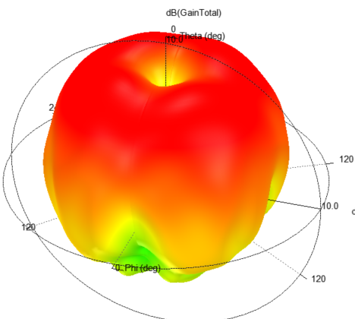
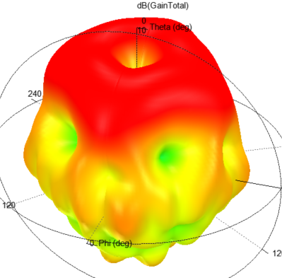

Slide 13
Characteristic Mode using FEKO
Mode 1 @ 3.4 GHz
Mode 11 @ 4.9 GHz
Mode 280 @ 5.6 GHz
Mode 247 @ 6.45 GHz
@ 3.35 GHz
@ 4.85 GHz
@ 5.55 GHz
@ 6.35 GHz
Radiation Pattern by HFSS

Slide 14
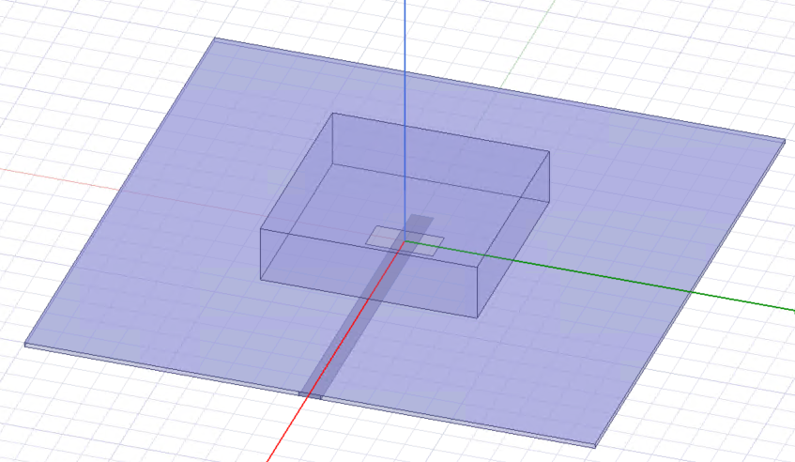
Aperture-feed DRA
Magnetic Dipole
imaging plane

Slide 15
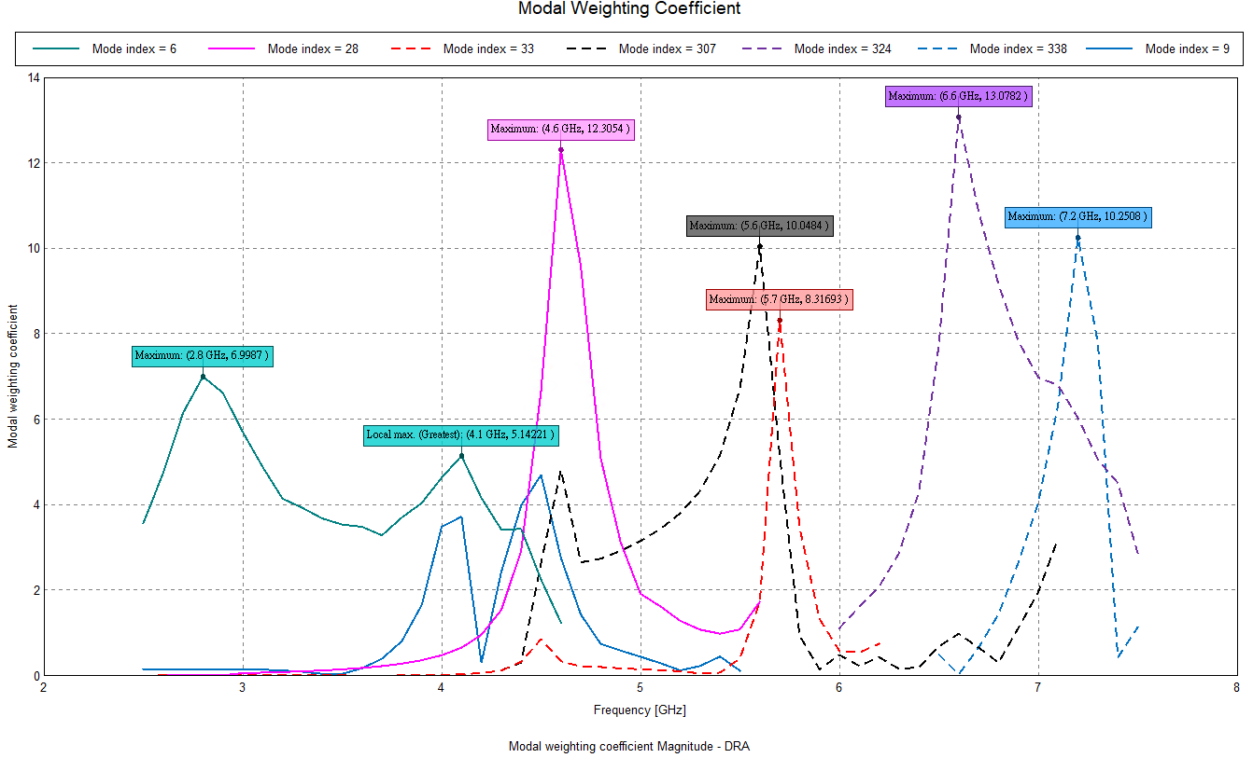

Slide 16
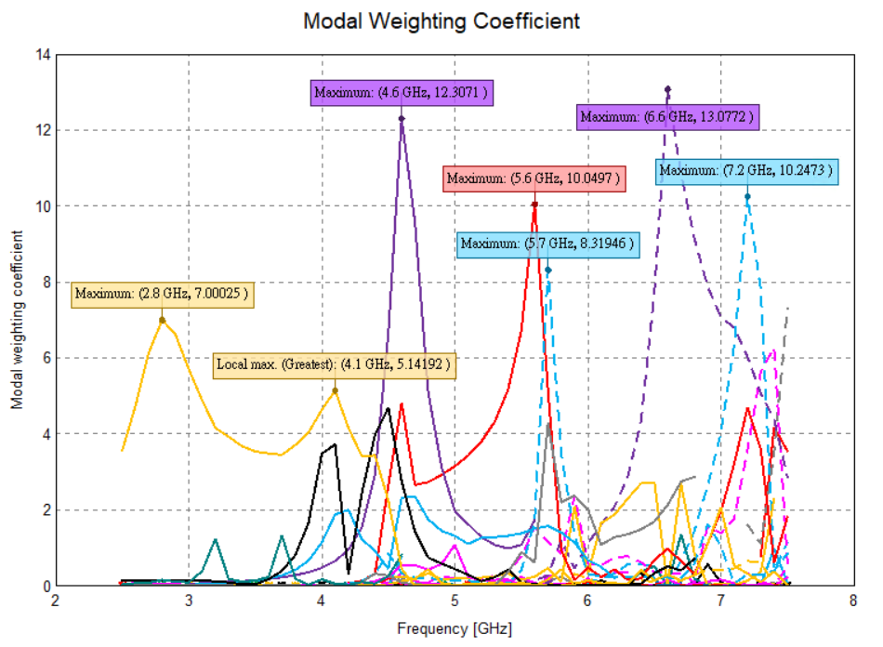

Slide 17
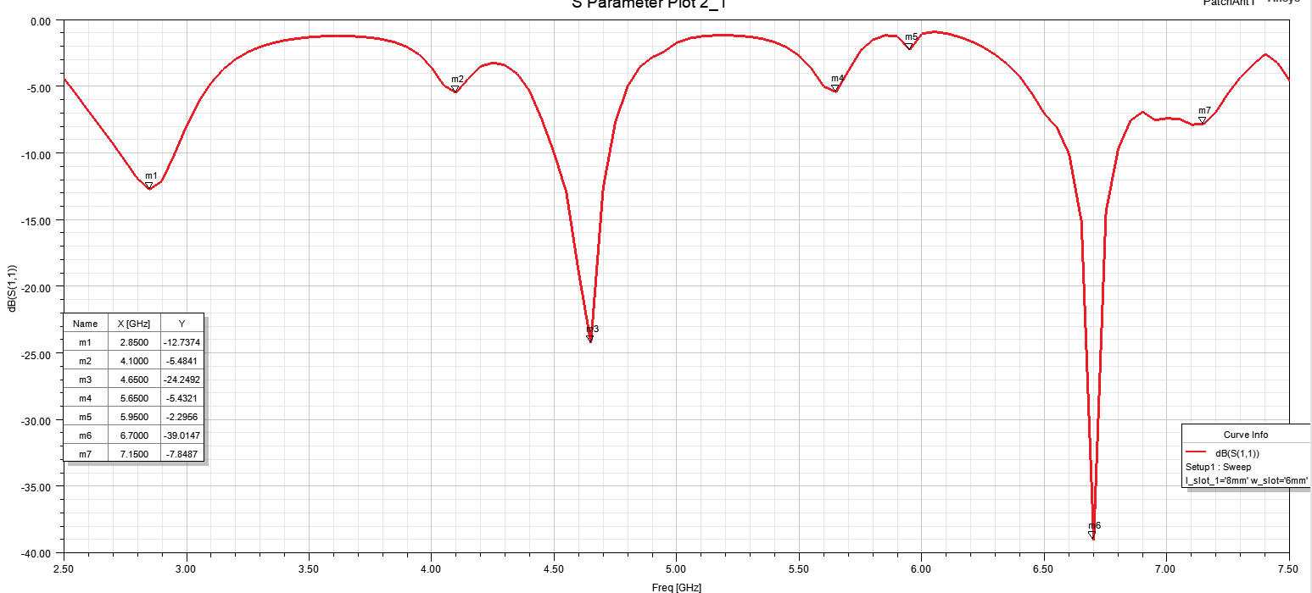
HFSS

Slide 18
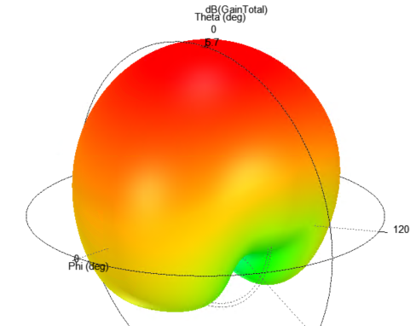
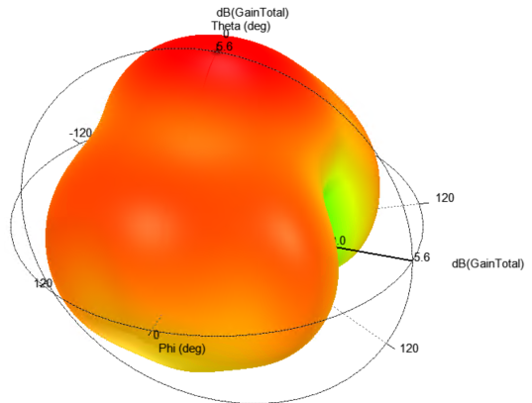
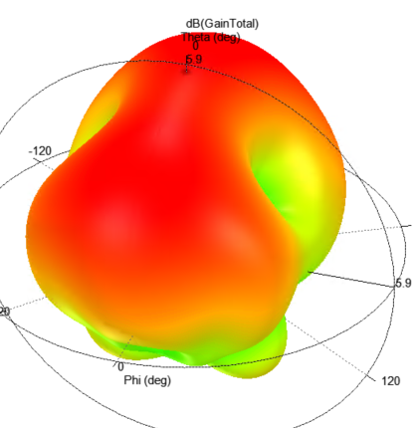
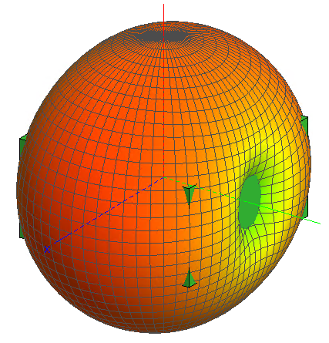
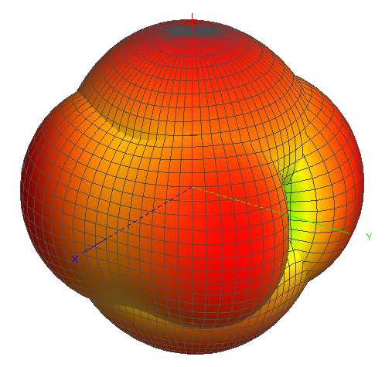
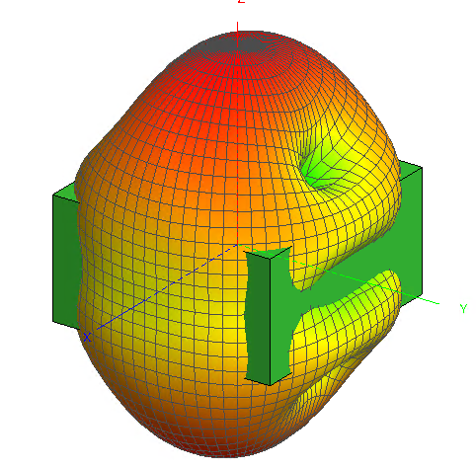
@ 2.85 GHz
@ 4.1 GHz
@ 4.65 GHz
Mode 6
Mode 6 + Mode 9
Mode 28

Slide 19
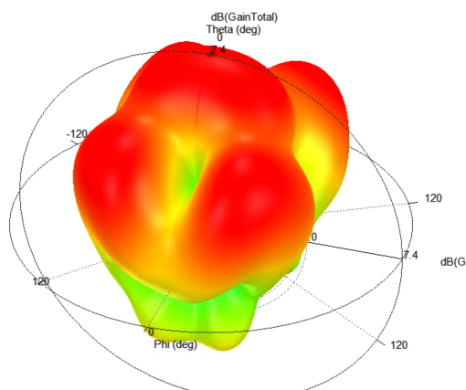
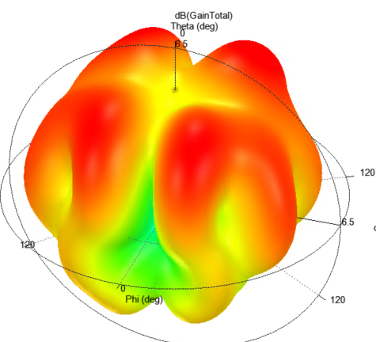
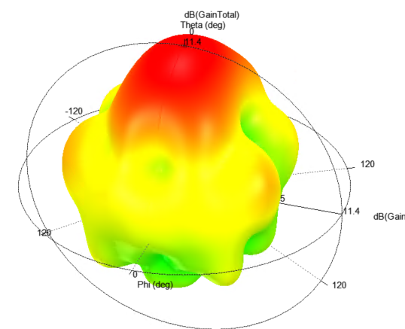
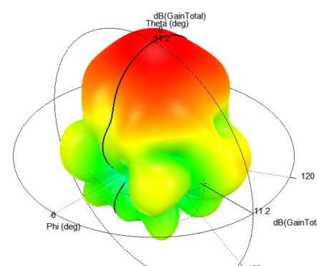
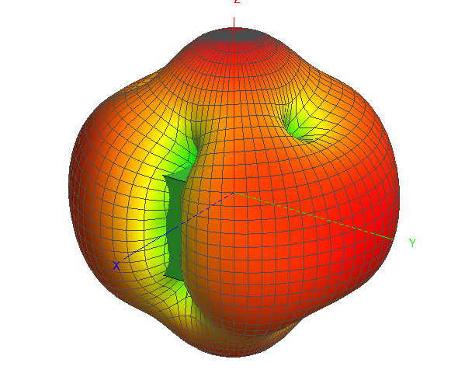
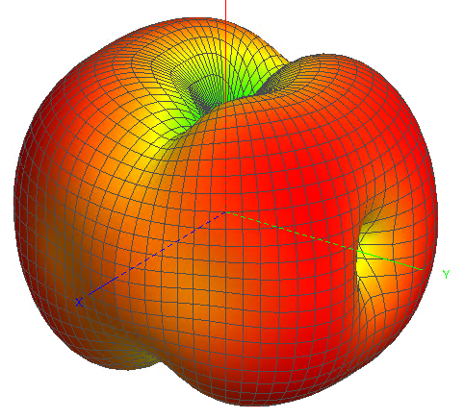
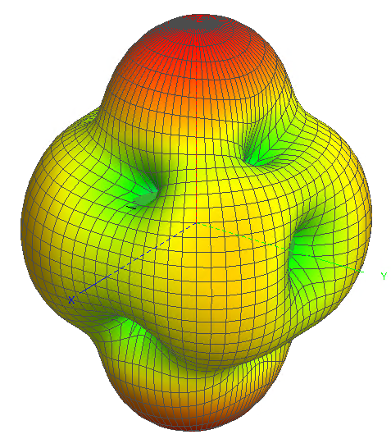
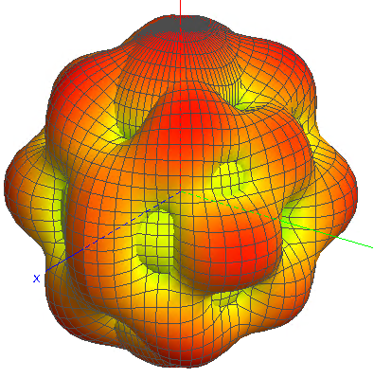
@ 5.65 GHz
@ 5.95 GHz
@ 6.7 GHz
@ 7.15 GHz
Mode 307
Mode 33
Mode 324
Mode 338

Slide 20
CMA of Patch Antenna

Slide 21
A | Lp | L/W | 44.7
B | Lul | Uh | 27.8
C | Wu | Uw | 16.9
D | Lur | Uh | 21.8
E
F
W | Ws | th/tw | 2.3
h | h | h | 11
 | Lp-Lub | Uo+Uh
 | Lub |  | 8.3
Uo=Lp-Lub-Uh=44.7-8.3-21.8=14.6

Slide 23
@0.815 GHz
@0.815 GHz
@1.065 GHz
@1.125 GHz
@1.035 GHz
@0.845 GHz
@1GHz

Slide 24
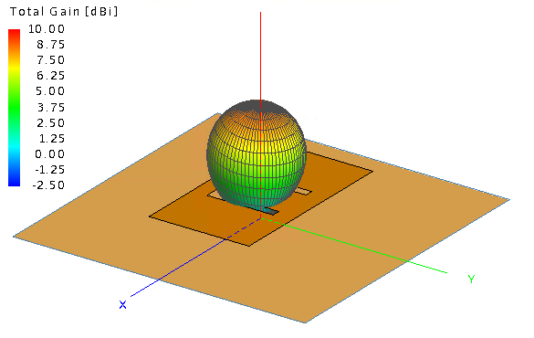
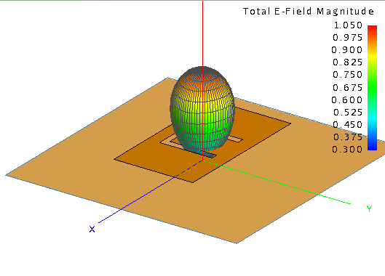
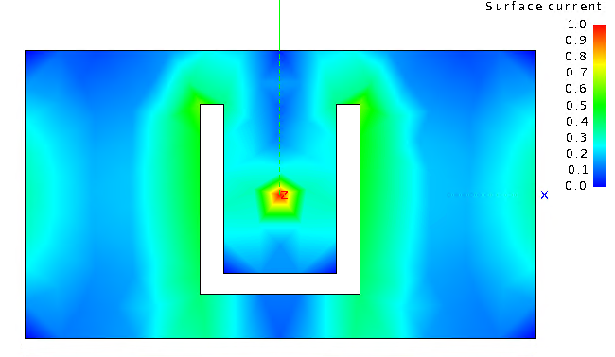
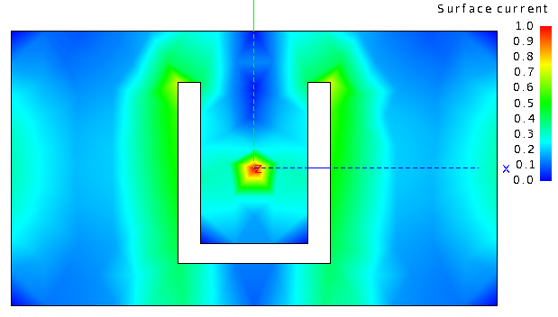
Mode 1

Slide 25




Mode 4

Slide 26


Mode 5
Can not be excited

Slide 27








Patch With Cuboid (acting as inductance)

Slide 28








Patch Only
不加馈电柱子，结果是跟cable馈电是不一致的，因为柱子相当于一个电感

Slide 29
CP Patch Antenna

Slide 30

CP excitation:
Same current amplitude
90-degree phase difference

Slide 31

Axial Ratio

Slide 32


It is possible to get a CP antenna if the two orthogonal modes can be excited simultaneously
Mode 1
Mode 2

Slide 33


Radiation Pattern
Phi = 0 deg
Phi = 90 deg

Slide 34



Slide 35


Axial Ratio without prob

Slide 36


Dipole (Modal Significance)

Slide 37

Dipole (Modal Significance)

Slide 38

S-parameter

Slide 39





Character Pattern of Mode1
Character Pattern of Mode2
Character Pattern of Mode3
Radiation Pattern @ 72 MHz
Radiation Pattern @ 220 MHz

